Slide 1
Data Preprocessing

Slide 2
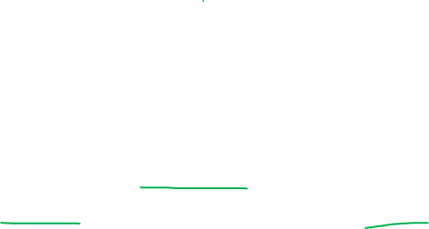
Preprocessing
It includes the steps required to convert a data into a more useful format.
The aim is to process the data and make it ready for the model creation stage.

Slide 3
Steps involved in preprocessing
Handling missing values
1
Treating the outliers
2
Scaling the dataset
3
Encoding the categorical variables
4

Slide 4
Handling missing values
All real-world datasets are incomplete. Data can be missing due to non-response, lost data or some skip patterns. Most of the features have some or the other missing values.

Slide 5
Methods of handling missing values

Slide 6
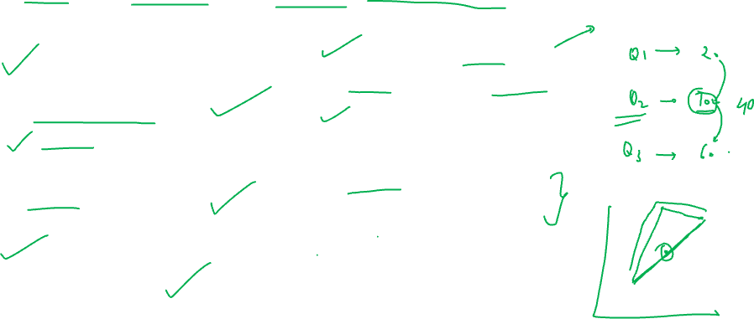
Mean / Median/ Mode imputation
Mean can be used to fill the missing values when the variable is numerical and it is normally distribution
Median can be used to fill the missing values when the variable is numerical and it is skewed (not normally distributed)
Mode can be used to fill missing values when variable is categorical
Advantages: It is easy to use.
Median is robust to outliers.
Quickest way to handle missing values
Disadvantages: It affects the variance of the dataset

Slide 7
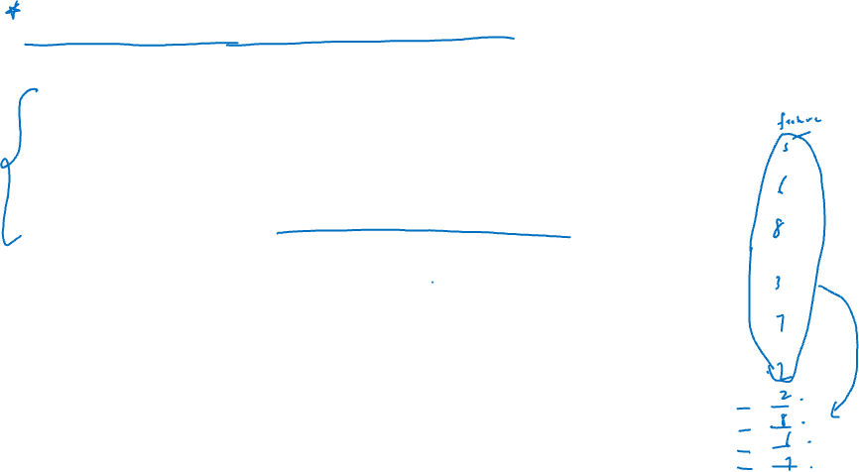
Random Sample Imputation
In this method a random value from the existing set of values is taken and used to fill the missing values.
Advantages: Easy and variance is same as original dataset

Slide 8
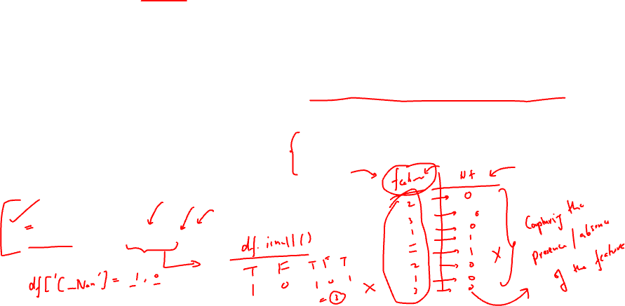
Capturing NaN value with a new feature
This method is used where the data is missing due to some cause. That is the data is not missing because of being completely random.
Here a new feature is created in the dataframe , in that feature 1 is stored for missing value and 0 is stored otherwise.
Df[‘C_NAN’] = np.where(df[‘C’].isnull(),1,0)
Advantages:
Easy to implement
Captures the missingness of the values
Disadvantage:
Increases the features of the dataset

Slide 9
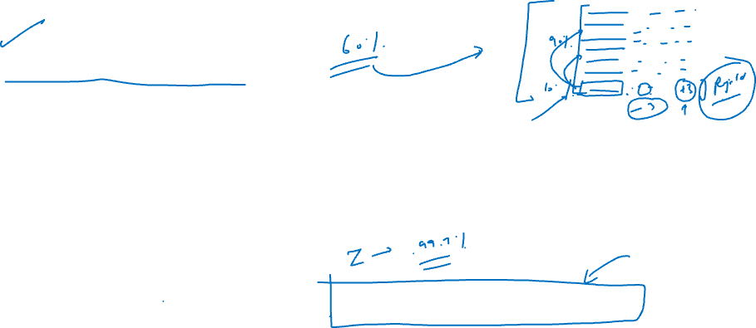
End of distribution
This is a special method , where the aim is to fill the missing values with some extreme value of the feature.
This method is specifically helpful when there are more extreme values in the dataset and the aim is to include those values in the model.
To find the extreme values use : Mean + /- 3* standard deviation

Slide 10
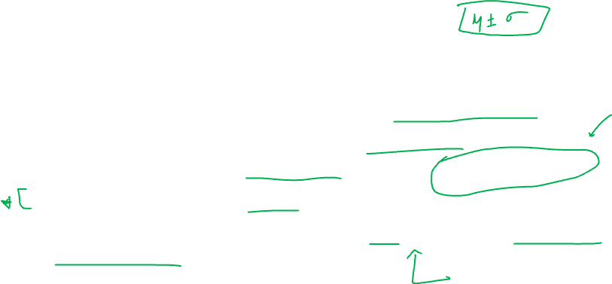
Arbitrary value imputation
This technique was invented by people in Kaggle competition.
Here each NaN value is replaced by an arbitrary value.
The decision about the arbitrary value is purely judgement based.
It must be a value that is not very frequent in the dataset
Generally it can be something like the minimum or the maximum value of the dataset

Slide 11

Frequent category imputation
When the variable is categorical , the best way to fill the missing values is with the most popular class.
This easy and fast way to handle categorical missing values
Disadvantage: this value may end up over representing the dataset

Slide 12
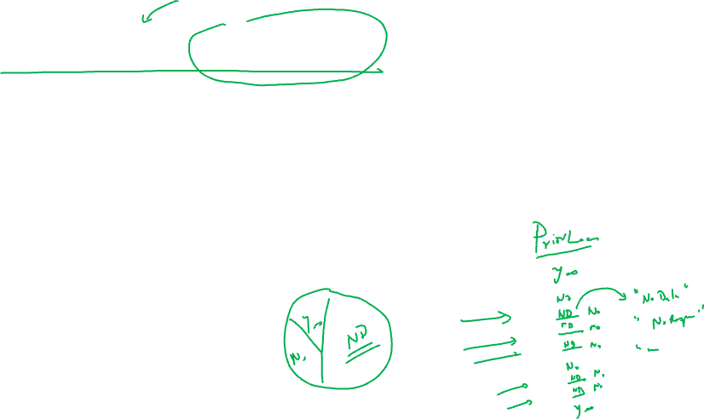
Treat NaN as new category
This is done in order to fill the values by a new category that can indicate that the values are missing.
So if there are already say three categories in that feature a fourth category is added for all the missing cells. It can be labeled as simple as ‘missing’

Slide 13
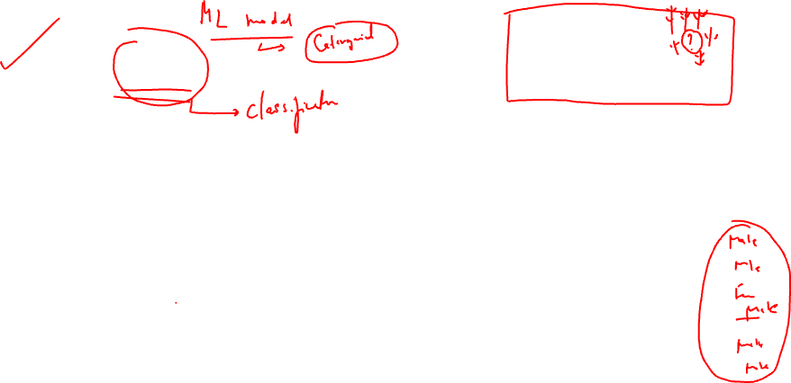
Using KNN imputation
KNN is a machine learning model, that relates to the prediction of classes based on the K nearest neighbours.
The same model or logic can be employed to even fill the missing categorical values

Slide 14
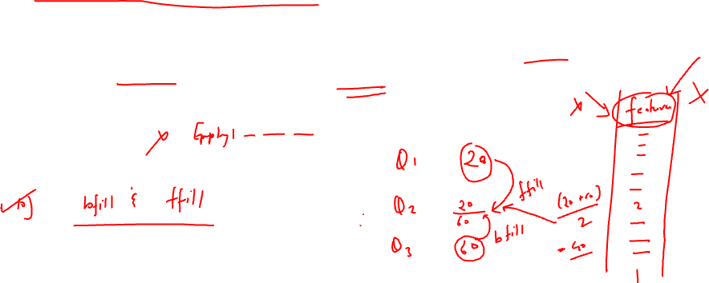
Drop all NaN values
When we deal with a feature that has approximately 60% or more values missing it is advisable to drop such features from the dataset.

Slide 15
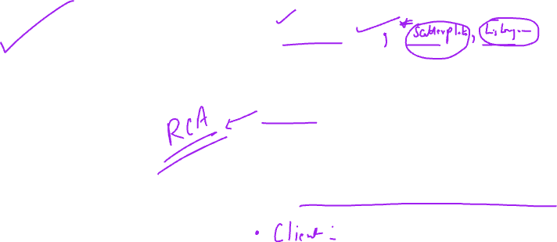
Handling Outliers
A value that differs significantly from the rest of the set of values is called outlier.
The best way to visualize an outlier is to plot a boxplot.
Once an outlier is noticed in the dataset as a data scientist our first action must be to analyze it. Find out the reasons and causes why this outlier has occurred and what does it indicate.
The correct interpretation of outlier is must.

Slide 16
Methods to handle outliers

Slide 17
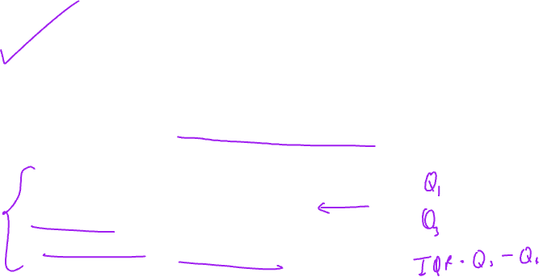
IQR method
When dataset is skewed or non-normal , IQR method of handling outliers is used.
Accordingly following defines an outlier:
Lower outliers = Q1 – 1.5*IQR
Upper outliers = Q3 + 1.5*IQR
A code can be created around similar steps to identify the outliers.

Slide 18
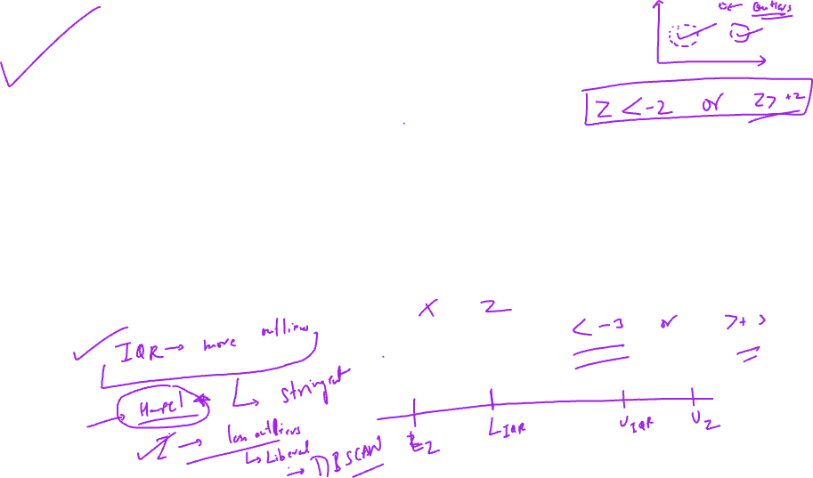
Z score method (Gaussian distribution)
This method is used when the dataset follows approximately normal distribution
Accordingly, any value that has a Z value less than -3 or greater than +3 is called an outlier.
Convert each value in to Z score and then filter out the values with magnitude greater than 3

Slide 19
Feature Scaling
When different features vary over different ranges, it becomes difficult to put them together in a model. This is more complex specifically when the model is based on distances.
Hence in such a case it is advised to scale down the features in such a way that all the features fall under the same range and hence can be readily used for model creation
This process of bringing all the features together in the same range is called feature scaling.

Slide 20
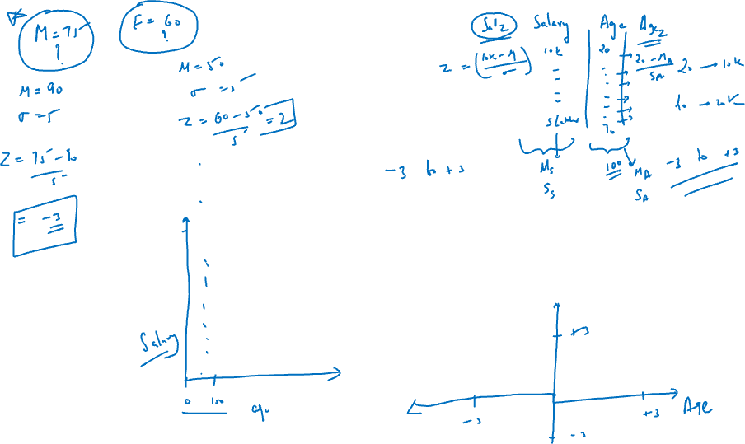
Different methods of feature scaling

Slide 21
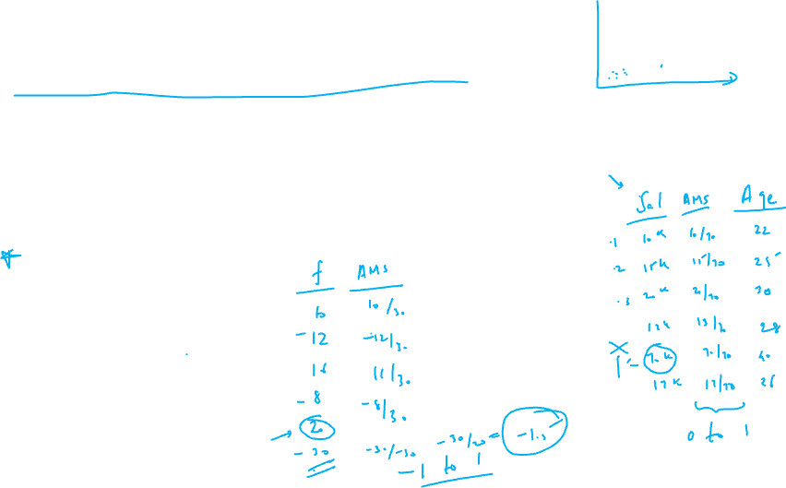
Absolute Maximum Scaling
According to this method , every value of the feature gets divided by the maximum value of the feature.
This converts all the values between – 1 and +1.
This method is quite prone to outliers.

Slide 22
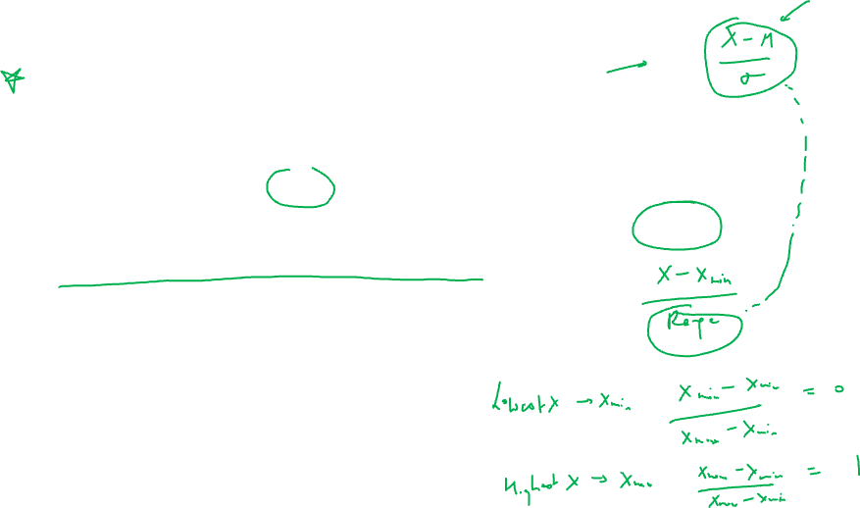
Min-max scaler
This method follows the below formula for scaling the values.
Scaled value = (X – Xmin) / (X max – X min)
The values created with this method lie in the range 0 to 1
But still the values are prone to outliers

Slide 23
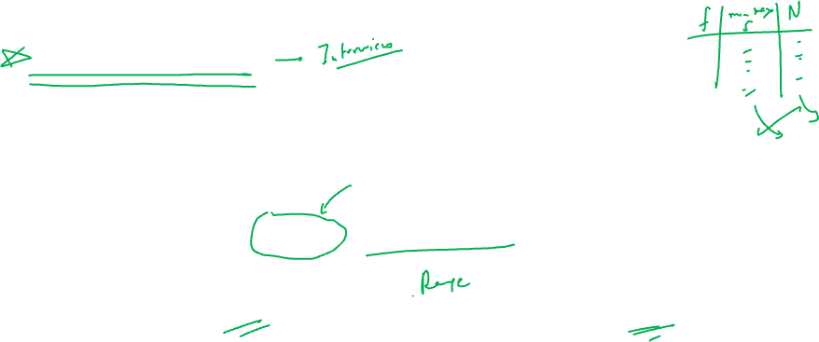
Normalization
In the methods before , the range of the value was being altered.
In this method of normalization the aim is to change the shape of the feature distribution.
Scaled value = (X – X mean) / (X max – X min)
Note: here the X min in numerator is replaced by the X mean value

Slide 24
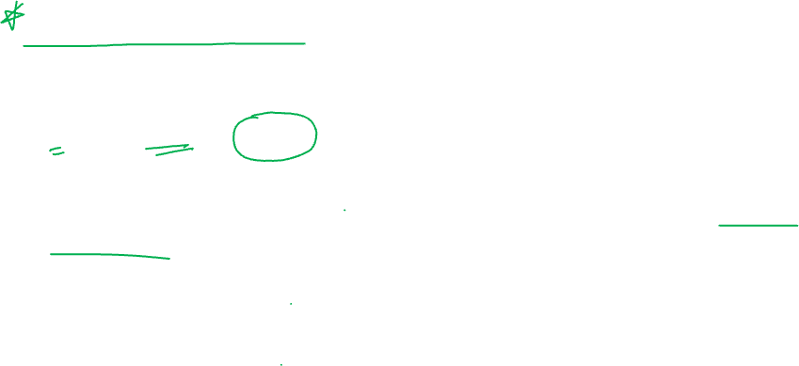
Standardization
This method converts each value of the feature to a Z score
Z = (X – Xmean) / X std
This method of scaling is best suited when the dataset follows normal distribution

Slide 25
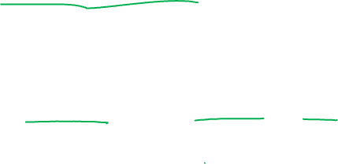
Robust scaling
When the dataset is skewed , a robust method of scaling is needed.
Accordingly the following formula is used to scale such a dataset.
Scaled value = (X – X median) / IQR

Slide 26
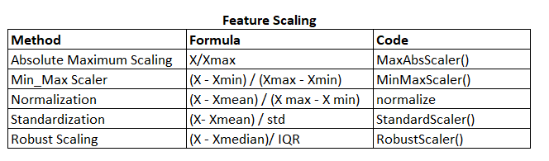
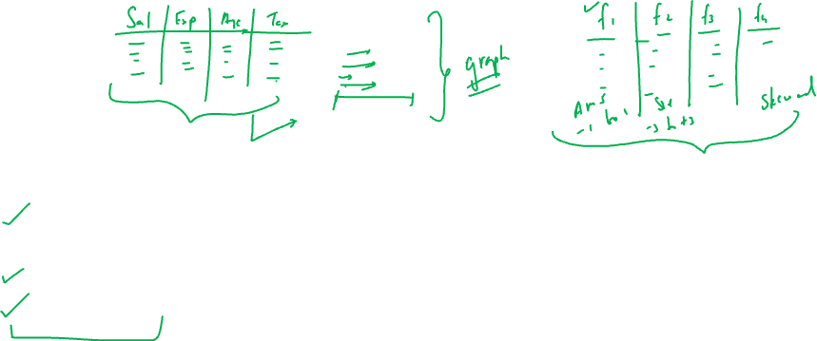

Slide 27
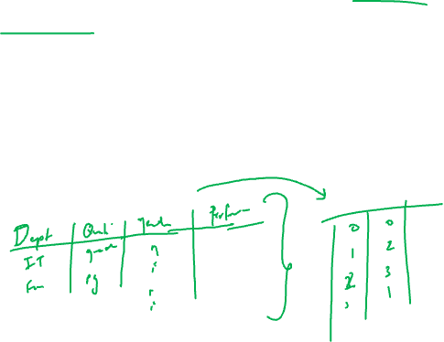
Encoding the dataset
In any dataset, there are several categorical features. Since machine learning model may fail to incorporate these variables it is important to convert them into some simple numerical codes.
This process of converting the categories or classes into simple codes is called encoding the dataset.

Slide 28
Methods of encoding

Slide 29

Nominal encoding:
OneHotEncoding: For each feature a number of features are created to encode. For example if a feature has two classes, then two new features are created. One feature captures the presence of first class and second feature captures the presence of second class.
OneHotEncoding with multiple categories: When there are several categories within a feature, this method comes to use. Accordingly only top 10 most common classes are considered and encoded.
Since OneHotEncoding method creates additional features it leads to curse of dimensionality.

Slide 30
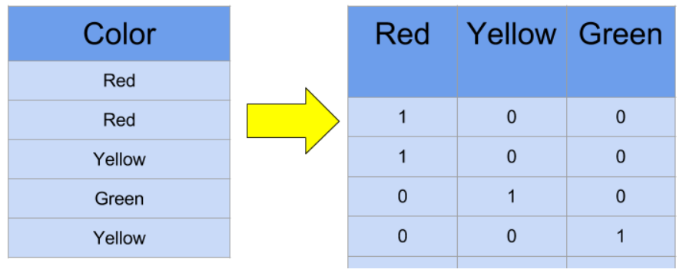
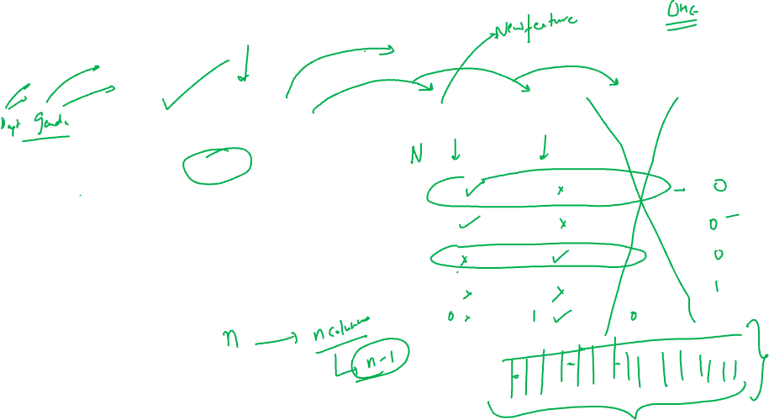

Slide 31
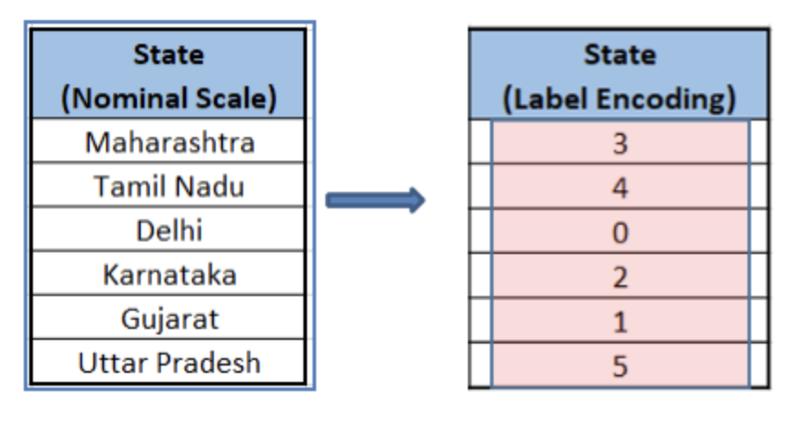
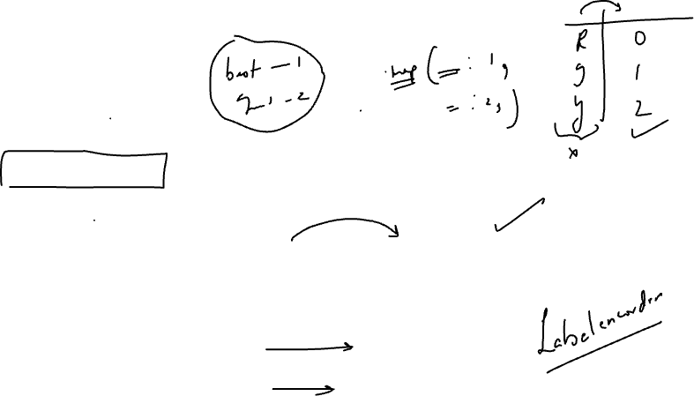
Ordinal encoding:
LabelEncoding: In this method the ordinal categories of the feature are automatically encoded by the LabelEncoder.

Slide 32
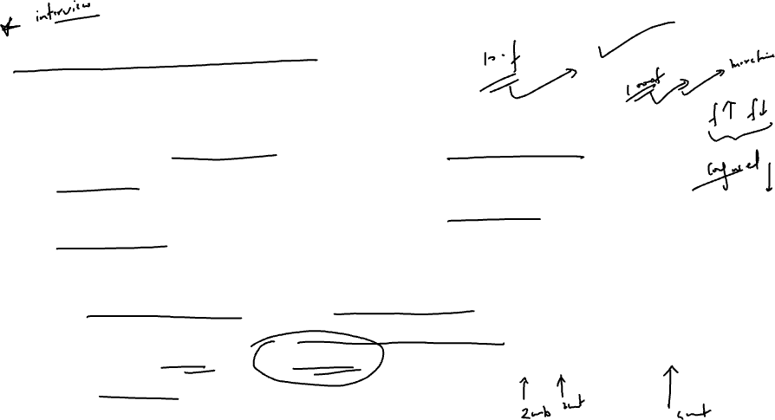
Curse of Dimensionality
Curse of dimensionality refers to the scenario where the exponential rise in the number of features leads to an decrease in model’s performance.
This is due to the fact that it is difficult to design models in higher dimensional space. (Imagine a space with 500 dimensions!)
Also, higher dimensions mean more information for the model to work on which increases the processing time involved and it also means more noise and redundancy in the dataset which makes the model erroneous.

